Slide 1


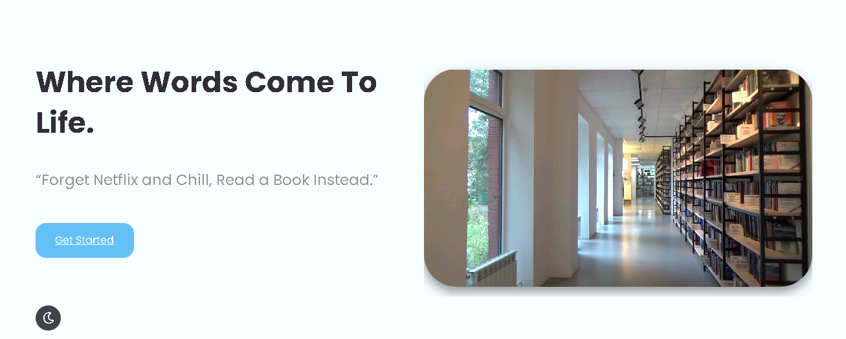
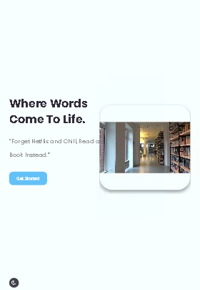
LIBRARY ADMINISTRATION TOOL
FY 23-24
Group 20
Group 20
Presented By:
Shashank Sharma
Mayur Awatade
Samruddhi Shende
Priti Bhakre
Chaitanya Tabhane

Slide 2

OUTLINE
Problem Statement
Objective
Project Overview
Architecture
Project Flow
Technology and Tools Used
Challenges and Learnings
Conclusion

Slide 3

PROBLEM STATEMENT
Designing a user-friendly library administration tool that empowers librarians to efficiently manage book inventory and member interactions.
This tool facilitate tasks such as adding new books to the catalogue, registering library members, and seamlessly handling book issuance and returns for readers.

Slide 4
OBJECTIVE
The main goal of the Library Administration Tool project is to create a tool that makes running a library easier and more efficient. The objectives are:
Simplify Tasks: Develop a tool that helps librarians quickly add new books to the library and sign-up new members without any hassle.
Easy Borrowing: Create a system that allows librarians to lend books to people and keep track of who has what, making borrowing and returning books smooth.
User-Friendly Interface: The tool's interface ensures that librarians of varying technical backgrounds can navigate and utilize its features effectively.

Slide 5

PROJECT OVERVIEW
PROJECT OVERVIEW
The Library Administration Tool is a user-friendly software designed for librarians to efficiently manage books and members.​
It allows librarians to easily add books, register members, and handle book borrowing and returns. ​
With feature like search capabilities, the tool enhances library operations and user experience.

Slide 6



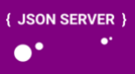





TECHNOLOGY & TOOLS USED

Slide 7
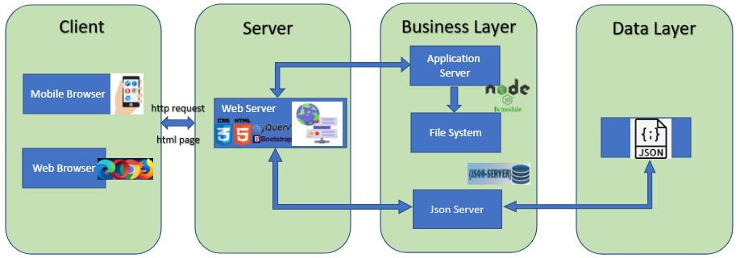
ARCHITECTURE
ARCHITECTURE

Slide 8
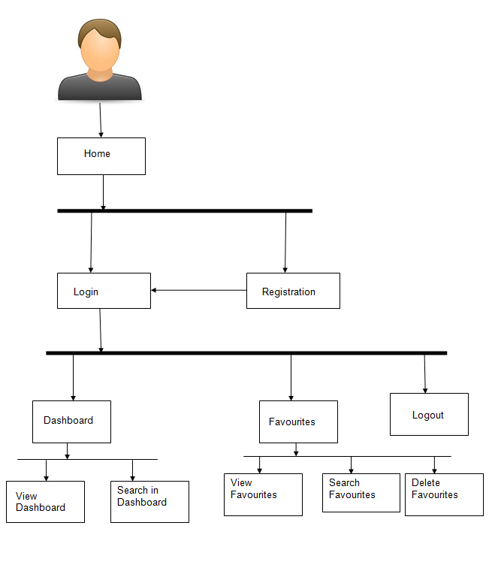
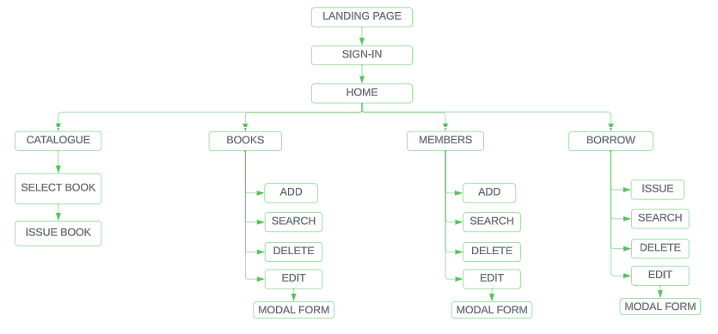
PROJECT FLOW

Slide 9
CONCLUSION
The Library Administration Tool makes running a library much easier. ​
Librarians can add books, sign up members, and keep track of who borrows what. It's like a helpful assistant that ensures everything is organized and helps people enjoy their library experience.​
It also sets the stage for more cooler thing's libraries can do in the future. This project is all about making libraries better for everyone.​

Slide 10
THANK YOU

